Slide 1
Working & Stay at Home Moms
Joe and Cindy Botti

Slide 2
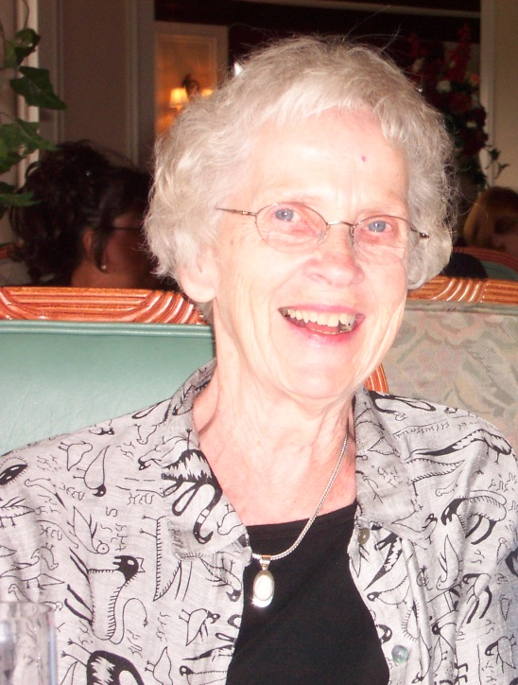
Cindy’s background
Not a Christian home
Abuse
Divorced
Single Parent

Slide 3
Joe’s background
Not a Christian home
Alcoholism
Italian Catholic
A lot of arguing

Slide 4
Our Family: Tom & Michelle Daniel Jenny & Tyler
Our kids:
Michelle
Jenny
Daniel
Psalm 100:5 For the Lord is good. His unfailing love continues forever, and his faithfulness continues to each generation.

Slide 5
God answered My Mom’s Prayer
Father, I cannot comprehend who you are. My mind cannot grasp all the things about You but I do know that you worked a miracle in my life as I look back on my life. You not only answer our prayers but you go above and beyond what we ask for. You have blessed my family—my son and daughter are believers; their spouses are believers—all my grandchildren are believers. This is a miracle because of the background that I came from.

Slide 6
God answered My Mom’s Prayer
Father, I cannot comprehend who You are. My mind cannot grasp all the things about You but I do know that You worked a miracle in my life as I look back on my life. You not only answer our prayers but You go above and beyond what we ask for. You have blessed my family—my son and daughter are believers; their spouses are believers—all my grandchildren are believers. This is a miracle because of the background that I came from. I don’t know how You did it. My prayers are puny but You put it all together. I thank You for how you worked in my children’s lives and their spouses’ lives. They are actively reaching out to the people around them and doing Your work. No person would be able to work all of this out but You were able to do this. Thank You for blessing my life.

Slide 7
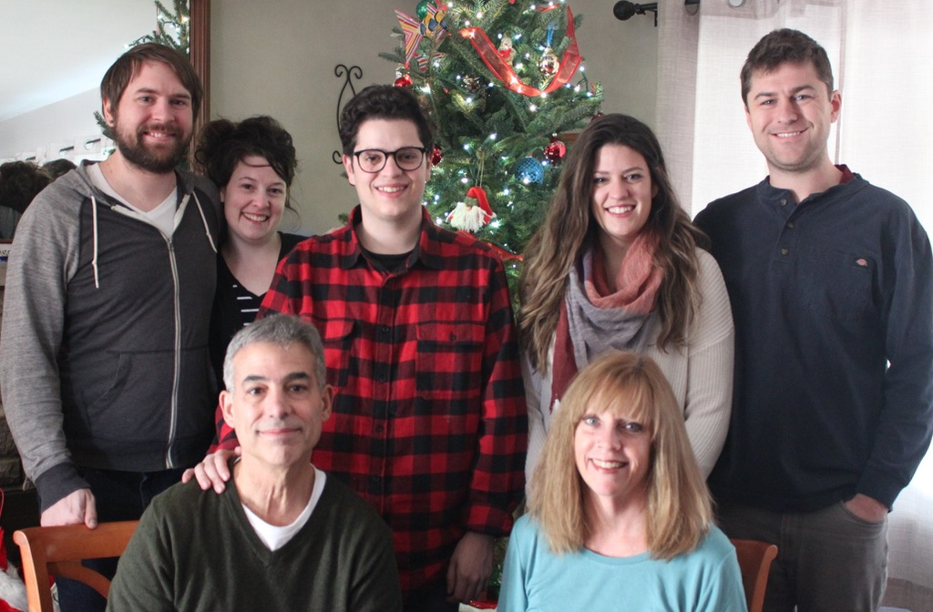
Not Experts
Share what we learned along the way
Need for God & Community

Slide 8
Work or Stay at Home?
Loved my career & job
Dad’s comment to me
Many fears
Many misconceptions
Sought advice from others
Decided…NO REGRETS!!!

Slide 9
A hinderance to my life/career
A frustrating obstacle to “real” ministry
An under-challenging occupation
A job too small for an intelligent capable human being
What parenting is not

Slide 10
Making sure my kids behave so I look good
Making sure my kids are always happy & get what they want
Making sure my kids succeed in this world
Making sure I do everything perfect for my children
Making sure my kids are free from any suffering
What parenting is not

Slide 11
Vision:
The most important job I could ever do!
God’s Point of View:
Children are gifts & rewards
What parenting is

Slide 12
Children are a gift from the Lord; they are a reward from him.
Children born to a young man are like arrows in a warrior’s hands.
How joyful is the man whose quiver is full of them!
Psalm 127:3-5a

Slide 13
Vision:
The most important job I could ever do!
God’s Point of View:
Children are gifts & rewards
What parenting is
Important role

Slide 14
“﻿﻿You shall love the Lord your God ﻿ ﻿with all your heart and with all your soul and with all your might. These words, which I am commanding you today, shall be on your heart. You shall teach them diligently to your sons and shall talk of them when you sit in your house and when you walk by the way and when you lie down and when you rise up.
Deuteronomy
6:5-7

Slide 15
“﻿﻿You shall love the Lord your God ﻿ ﻿with all your heart and with all your soul and with all your might. These words, which I am commanding you today, shall be on your heart. You shall teach them diligently to your sons and shall talk of them when you sit in your house and when you walk by the way and when you lie down and when you rise up.
Deuteronomy
6:5-7

Slide 16
⁴ We will not hide these truths from our children; we will tell the next generation about the glorious deeds of the Lord, about his power and his mighty wonders.
⁵…Which He commanded our fathers that they should teach them to their children, that the generation to come might know, even the children yet to be born, that they may arise and tell them to their children, that they should put their confidence in God and not forget the works of God, but keep His commandments,
Psalm 78:4-7

Slide 17
⁴ We will not hide these truths from our children; we will tell the next generation about the glorious deeds of the Lord, about his power and his mighty wonders.
⁵…Which He commanded our fathers that they should teach them to their children, that the generation to come might know, even the children yet to be born, that they may arise and tell them to their children, that they should put their confidence in God and not forget the works of God, but keep His commandments,
Psalm 78:4-7

Slide 18
⁴ We will not hide these truths from our children; we will tell the next generation about the glorious deeds of the Lord, about his power and his mighty wonders.
⁵…Which He commanded our fathers that they should teach them to their children, that the generation to come might know, even the children yet to be born, that they may arise and tell them to their children, that they should put their confidence in God and not forget the works of God, but keep His commandments,
Psalm 78:4-7

Slide 19
⁴ We will not hide these truths from our children; we will tell the next generation about the glorious deeds of the Lord, about his power and his mighty wonders.
⁵…Which He commanded our fathers that they should teach them to their children, that the generation to come might know, even the children yet to be born, that they may arise and tell them to their children, that they should put their confidence in God and not forget the works of God, but keep His commandments,
Psalm 78:4-7

Slide 20
Andrew Murray
It was God’s plan for the family with its love and its training of the children to reflect the fellowship of God’s home and the love of the Father in heaven (Murray 12).

Slide 21
Andrew Murray
It was God’s plan for the family with its love and its training of the children to reflect the fellowship of God’s home and the love of the Father in heaven (Murray 12).
What could be more important?

Slide 22
“Family and other relationships are important to the development of what I call one’s private God. “No child arrives at the ‘house of God’ without his “pet God” under his arm.”
And for some of us the “pet God” we have tied on a leash to our hearts is not very nice, nor is it biblically accurate. This is because our negative images of God are often rooted in our emotional hurts and destructive patterns of relating to people that we carry with us from our past”(56).

Slide 23
Vision:
The most important job I could ever do!
God’s Point of View:
Children are gifts & rewards
What parenting is
Important role
A Blessing

Slide 24
She carefully watches everything in her household
and suffers nothing from laziness.
Her children stand and bless her.
Her husband praises her: “There are many virtuous and capable women in the world,
but you surpass them all!” Charm is deceptive, and beauty does not last;
but a woman who fears the Lord will be greatly praised.
Proverbs 31

Slide 25
She carefully watches everything in her household
and suffers nothing from laziness.
Her children stand and bless her.
Her husband praises her: “There are many virtuous and capable women in the world,
but you surpass them all!” Charm is deceptive, and beauty does not last;
but a woman who fears the Lord will be greatly praised.
Proverbs 31

Slide 26
She carefully watches everything in her household
and suffers nothing from laziness.
Her children stand and bless her.
Her husband praises her: “There are many virtuous and capable women in the world,
but you surpass them all!” Charm is deceptive, and beauty does not last;
but a woman who fears the Lord will be greatly praised.
Proverbs 31

Slide 27
She carefully watches everything in her household
and suffers nothing from laziness.
Her children stand and bless her.
Her husband praises her: “There are many virtuous and capable women in the world,
but you surpass them all!” Charm is deceptive, and beauty does not last;
but a woman who fears the Lord will be greatly praised.
Proverbs 31

Slide 28
Edith Schaeffer
Over and over again, someone in a relationship needs to consider the family as a career, a project, serious enough to be willing to be the one to “scramble up over jagged rocks to free the birds, so that they won’t become extinct.” Taking on the career of being a mother and wife is a fabulously rare lifework in the 20th century, and a very challenging job.

Slide 29
Edith Schaeffer
Over and over again, someone in a relationship needs to consider the family as a career, a project, serious enough to be willing to be the one to “scramble up over jagged rocks to free the birds, so that they won’t become extinct.” Taking on the career of being a mother and wife is a fabulously rare lifework in the 20th century, and a very challenging job.

Slide 30
Edith Schaeffer
Over and over again, someone in a relationship needs to consider the family as a career, a project, serious enough to be willing to be the one to “scramble up over jagged rocks to free the birds, so that they won’t become extinct.” Taking on the career of being a mother and wife is a fabulously rare lifework in the 20th century, and a very challenging job.

Slide 31
Edith Schaeffer
A wasted effort? A thankless job? An undignified slave? No, a most exciting possibility of turning the tide, of saving the species, of affecting history, of doing something that will be felt and heard in ever-widening circles (Schaeffer 47).

Slide 32
Edith Schaeffer
A wasted effort? A thankless job? An undignified slave? No, a most exciting possibility of turning the tide, of saving the species, of affecting history, of doing something that will be felt and heard in ever-widening circles (Schaeffer 47).
Not our culture’s view!

Slide 33
Common comments to Stay-at-Home Moms
“What do you do all day long?”
“How nice it must be not to have to get up and work every day like I have to.”
“I wish I could stay home like you but someone has to work and pay the bills!”
“What about all that education we paid for?”

Slide 35
Swimming upstream!

Slide 36
God’s Purpose in Parenting vs The World’s
God has a purpose for the family
We must recognize that God has a purpose for the family. The Christian family is not an island. It is not intended to be an end in itself, but rather a means to a greater end. God wants the Christian family involved in His purpose and plan (Fleming 29)

Slide 37
God’s Purpose in Parenting vs The World’s
God has a purpose for the family
We must recognize that God has a purpose for the family. The Christian family is not an island. It is not intended to be an end in itself, but rather a means to a greater end. God wants the Christian family involved in His purpose and plan (Fleming 29)

Slide 38
God’s Purpose in Parenting vs The World’s
God has a purpose for the family
We must recognize that God has a purpose for the family. The Christian family is not an island. It is not intended to be an end in itself, but rather a means to a greater end. God wants the Christian family involved in His purpose and plan (Fleming 29)

Slide 39
God’s Purpose in Parenting vs The World’s
God has a purpose for the family
We must recognize that God has a purpose for the family. The Christian family is not an island. It is not intended to be an end in itself, but rather a means to a greater end. God wants the Christian family involved in His purpose and plan (Fleming 29)

Slide 40
God’s Purpose in Parenting vs The World’s
God’s Purpose
Provide the best possible environment for our kids to develop

Slide 41
Jean Fleming
God established the family as the best possible environment for human development. In God’s plan the family provides a secure and loving framework in which to nourish the child—emotionally, intellectually, physically, and spiritually. The family is called to provide nurture, instruction, and discipline (Fleming 20).

Slide 42
Jean Fleming
God established the family as the best possible environment for human development. In God’s plan the family provides a secure and loving framework in which to nourish the child—emotionally, intellectually, physically, and spiritually. The family is called to provide nurture, instruction, and discipline (Fleming 20).

Slide 43
God’s Purpose in Parenting vs The World’s
God’s Purpose
Provide the best possible environment for our kids to develop
Love God
Love Your Neighbor

Slide 44
Matthew 22:37-40
Based on 2 Commandments
“’You shall love the Lord your God with all your heart, and with all your soul, and with all your mind.’ ³⁸ This is the greatest and foremost commandment.

Slide 45
Matthew 22:37-40
Based on 2 Commandments
“’You shall love the Lord your God with all your heart, and with all your soul, and with all your mind.’ ³⁸ This is the greatest and foremost commandment.
³⁹ The second is like it, ‘You shall love your neighbor as yourself.’ ⁴⁰ On these two commandments depend the whole Law and the Prophets.”

Slide 46
Edith Schaeffer
No Christian family is meant to live behind a moat filled with water and a drawbridge swung up out of reach! To protect your family life to this extent, to save your family life in complete selfishness, is to lose it in the end (Schaeffer 231).

Slide 47
Edith Schaeffer
“There is nothing that is more helpful for your own children than their becoming involved in compassion for people. There is nothing more beneficial for your children than discovering how exciting it is to know that someone has ‘passed from darkness to light’ because of the times spent in your home.

Slide 48
Edith Schaeffer
“There is nothing that is more helpful for your own children than their becoming involved in compassion for people. There is nothing more beneficial for your children than discovering how exciting it is to know that someone has ‘passed from darkness to light’ because of the times spent in your home.
To find that happiness really comes in the midst of seeing someone else helped—especially if helped to find eternal life, as well as to begin to have a changed life here—teaches the whole family what life is all about.”
Example:
Taking a teenage girl into our home

Slide 49
Love the world!
The World’s Purpose

Slide 50
Love the world!
The World’s Purpose
1 John 2: ¹⁵ Do not love the world nor the things in the world. If anyone loves the world, the love of the Father is not in him. ¹⁶ For all that is in the world, the lust of the flesh and the lust of the eyes and the boastful pride of life, is not from the Father, but is from the world. ¹⁷ The world is passing away, and also its lusts; but the one who does the will of God lives forever.

Slide 51
Love the world!
The World’s Purpose
1 John 2: ¹⁵ Do not love the world nor the things in the world. If anyone loves the world, the love of the Father is not in him. ¹⁶ For all that is in the world, the lust of the flesh and the lust of the eyes and the boastful pride of life, is not from the Father, but is from the world. ¹⁷ The world is passing away, and also its lusts; but the one who does the will of God lives forever.

Slide 52
Conform to the world!
The World’s Purpose

Slide 53
Conform to the world!
The World’s Purpose
Romans 12: 2 And do not be conformed to this world, but be transformed by the renewing of your mind, so that you may prove what the will of God is, that which is good and acceptable and perfect.

Slide 54
Conform to the world!
The World’s Purpose
Romans 12: 2 And do not be conformed to this world, but be transformed by the renewing of your mind, so that you may prove what the will of God is, that which is good and acceptable and perfect.

Slide 56
How ?
Value what God Values
Not the World’s Values!

Slide 57
Value what God Values
What does God value?
Relationship

Slide 58
Edith Schaeffer
A family is a formation center for human relationships. The family is the place where the deep understanding that people are significant, important, worthwhile, with a purpose in life, should be learned at an early age. The family is the place where children should learn that human beings have been made in the image of God and are therefore very special in the universe (Schaeffer 69).

Slide 59
Value what God Values
What does God value?
Relationship
Character

Slide 60
Edith Schaeffer
The family is the place where loyalty, dependability, trustworthiness, compassion, sensitivity to others, thoughtfulness, and unselfishness are supposed to have their roots. Someone must take the initiative and use imagination to intentionally teach these things (Schaeffer 83).

Slide 61
What does this world value?
Power and Position
Be the most popular
Best athlete
Best artist
Best student
Prestigious profession
Self is first and center

Slide 62
What does God value?
Be a servant
Matthew 20:26-27 “Whoever wants to become great among you must be your servant, and whoever wants to be first must be your slave.”

Slide 63
What does this world value?
Externals
Physical beauty
Best body
Outward behavior

Slide 64
What does God value?
Inner Qualities
1 Samuel 16:7 “Do not consider his appearance or his height, for I have rejected him. The Lord does not look at the things man looks at. Man looks at the outward appearance, but the Lord looks at the heart.”

Slide 65
What does God value?
Inner Qualities
1 Samuel 16:7 “Do not consider his appearance or his height, for I have rejected him. The Lord does not look at the things man looks at. Man looks at the outward appearance, but the Lord looks at the heart.”

Slide 66
What does this world value?
Wealth and Material Things
Best schools/ colleges
Best scholarships
To get rich
Accumulate things

Slide 67
What does God value?
Contentment / Godliness
1 Timothy 6
⁶ But godliness actually is a means of great gain when accompanied by contentment. ⁷ For we have brought nothing into the world, so we cannot take anything out of it either. ⁸ If we have food and covering, with these we shall be content.

Slide 68
What does God value?
Contentment / Godliness
1 Timothy 6
⁶ But godliness actually is a means of great gain when accompanied by contentment. ⁷ For we have brought nothing into the world, so we cannot take anything out of it either. ⁸ If we have food and covering, with these we shall be content.

Slide 69
What does God value?
Contentment / Godliness
⁹ But those who want to get rich fall into temptation and a snare and many foolish and harmful desires which plunge men into ruin and destruction. ¹⁰ For the love of money is a root of all sorts of evil, and some by longing for it have wandered away from the faith and pierced themselves with many griefs.

Slide 70
What does God value?
Contentment / Godliness
⁹ But those who want to get rich fall into temptation and a snare and many foolish and harmful desires which plunge men into ruin and destruction. ¹⁰ For the love of money is a root of all sorts of evil, and some by longing for it have wandered away from the faith and pierced themselves with many griefs.

Slide 71
What does this world value?
Temporal Things
Perfect circumstances
Comfort
Avoid all suffering
Giving what they want rather than what is good for them

Slide 72
What does God value?
Eternal Things
2 Corinthians 4
¹⁶ Therefore we do not lose heart, but though our outer man is decaying, yet our inner man is being renewed day by day. ¹⁷ For momentary, light affliction is producing for us an eternal weight of glory far beyond all comparison

Slide 73
What does God value?
Eternal Things
2 Corinthians 4
¹⁸ while we look not at the things which are seen, but at the things which are not seen; for the things which are seen are temporal, but the things which are not seen are eternal.

Slide 74
What does God value?
Eternal Things
Matthew 6
¹⁹ “Don’t store up treasures here on earth, where moths eat them and rust destroys them, and where thieves break in and steal. ²⁰ Store your treasures in heaven, where moths and rust cannot destroy, and thieves do not break in and steal. ²¹ Wherever your treasure is, there the desires of your heart will also be.

Slide 75
What does God value?
Eternal Things
Matthew 6
¹⁹ “Don’t store up treasures here on earth, where moths eat them and rust destroys them, and where thieves break in and steal. ²⁰ Store your treasures in heaven, where moths and rust cannot destroy, and thieves do not break in and steal. ²¹ Wherever your treasure is, there the desires of your heart will also be.

Slide 76
How ?
Value what God Values
Not the World’s Values!
Joe
Quality vs Quantity Time

Slide 77
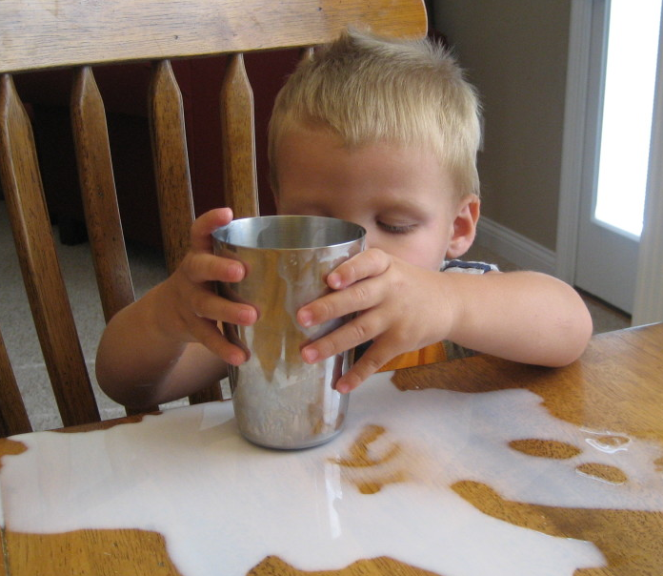
Both!
Kids need our guidance, protection, and nurture
Quality vs Quantity?

Slide 78
Quality vs Quantity?
Both!
Kids need our guidance, protection, and nurture
Kids need loving discipline, which takes time and energy
“Busy parents already feel guilty about the little time they have to spend with their children. Few of them want to "waste time" in conflict and anger and as a result are often only too happy to sidestep discipline issues.

Slide 79
Quality vs Quantity?
Both!
Kids need our guidance, protection, and nurture
Kids need loving discipline, which takes time and energy
The unfortunate result is that children do not learn how to take responsibility, control their impulses, or be thoughtful.”
-Madeline Levine, PhD The Price of Privilege pg 153

Slide 80
Quality vs Quantity?
Both!
Kids need our guidance, protection, and nurture
Kids need loving discipline, which takes time and energy
Difficult to have quality time if the quantity isn’t there consistently
If little quantity time, more pressure & stress on parents to make it quality
More pressure & anxiety on child because they know whatever time they get now might be it for a while

Slide 81
Quality vs Quantity?
Both!
Kids need our guidance, protection, and nurture
Kids need loving discipline, which takes time and energy
Difficult to have quality time if the quantity isn’t there consistently
The relationship also needs quality time

Slide 82
Quality vs Quantity?
Levine writes…
“Warmth is the quality of involvement, understanding, acceptance, and love that parents communicate on different levels and in ever-evolving ways as their children grow.” Children with warm connected parents are better adjusted.”
“With friends….We listen long enough to know what it feels like to be in their shoes. Too often with our children, we rush in and offer suggestions, propose alternatives, or solve problems.”

Slide 83
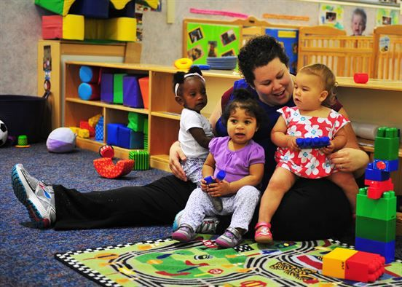
Quality vs Quantity?
Non-Parental Care Considerations
Many families need to go this route to one degree or another
Try to minimize, especially day-care

Slide 84
Quality vs Quantity?
Non-Parental Care Considerations
Many families need to go this route
Try to minimize, especially day-care
Psychology Today -The Trouble With Day Care. Heide Lang, May, 2005
“Few parents have heard about the National Institute of Child Health and Human Development (NICHD) Study of Early Child Care, an ongoing $100 million survey of 1,100 children (2005). It's the largest and most rigorous examination of day care in history,

Slide 85
Quality vs Quantity?
Non-Parental Care Considerations
Many families need to go this route
Try to minimize, especially day-care
“taking into account family income and the quality of day care. Evidence from the study shows that the total number of hours a child is without a parent, from birth through preschool, matters. The more time in child care of any kind or quality, the more aggressive the child, according to results published in Child Development.”

Slide 86
Quality vs Quantity?
Non-Parental Care Considerations
Many families need to go this route
Try to minimize, especially day-care
“Children in full-time day care were close to three times more likely to show behavior problems than those cared for by their mothers at home.” Although Belsky's harsh words haven't won him many friends, some researchers think he has a point. Kathy McCartney, an education professor at Harvard and another NICHD day care researcher, concedes the

Slide 87
Quality vs Quantity?
Non-Parental Care Considerations
Many families need to go this route
Try to minimize, especially day-care
aggression results are significant, but won’t offer cautionary advice without more research. "So far it is looking like he's right," says McCartney, who criticized Belsky's claims in the past. "Long hours in child care are associated with behavior problems.”
-Psychology Today -The Trouble With Day Care. Heide Lang, May, 2005

Slide 88
Quality vs Quantity?
Non-Parental Care Considerations
Many families need to go this route
Try to minimize, especially day-care
Belsky now urges that, if at all possible, a parent stay home with children less than two years old, and calls for government help to make that easier.”
-Karl Zinsmeister, April 21, 1988. Testimony to the House Committee on Education and Labor Subcommittee on Human Resources

Slide 89
Quality vs Quantity?
Non-Parental Care Considerations
Many families need to go this route
Try to minimize, especially day-care
Attachment
Goal is to create a secure attachment
Minimize non-parental care
John Bowlby was a British psychologist and psychoanalyst who believed that early childhood attachments played a critical role in later development and mental functioning. His work, along with the work of psychologist Mary Ainsworth,

Slide 90
Quality vs Quantity?
Non-Parental Care Considerations
Many families need to go this route
Try to minimize, especially day-care
Attachment
Goal is to create a secure attachment
contributed to the development of attachment theory. Bowlby shared the psychoanalytic view that early experiences in childhood are important for influencing development and behavior later in life. Our early attachment styles are established in childhood through the infant/caregiver relationship.

Slide 91
Quality vs Quantity?
“While forming a secure attachment with caregivers is normal and expected, as Hazan and Shaver have noted, it doesn't always happen. Researchers have found a number of different factors that contribute to the development (or lack thereof) of secure attachment, particularly a mother's responsiveness to her infant's needs during the first year of a child's life.”
“Bowlby believed that the earliest bonds formed by children with their caregivers have a tremendous impact that continues throughout life. “ -The Story of Bowlby, Ainsworth, and Attachment Theory The Importance of Early Emotional Bonds By Kendra Cherry, March 17, 2019

Slide 92
Quality vs Quantity?
Non-Parental Care Considerations
Many families need to go this route
Try to minimize, especially day-care

Slide 93
One on One Time (Date)
Start Young
Make it fun!
Relational
Spiritual
“In raising children, everything depends on the love relationship between parent and child. Nothing works well if a child’s love needs are not met.” “Only the child who feels genuinely loved and cared for can do her best.”
-Chapman & Campbell, The 5 Love Languages of Children, pg 17

Slide 94
One on One Time (Date)
Infants to Age 4
Interact with nature
Touch and feel
Develop creativity & problem solving
Lots of make believe stories, dolls
Ride a tricycle
Associate you with fun

Slide 95
One on One Time (Date)
Ages 5 to 10
Develop emotional Life
Michelle: Mondays after school.
Fun & creativity
Daniel: Saturday morning at Tim Horton’s playing Hot Wheels. Dirt pile for trucks.
Simple
Help develop their interests
Jenny: Sunday mornings Bob Evans, at the counter
Projects: Portable gerbil cage and maze.

Slide 96
One on One Time (Date)
Ages 5 to 10
Lots of nature
Creeking, fishing, etc
Keep it fun
Build small boats for demolition on the river
Less time for organized sports
Our kids: about age 10.
Coach
Develop spiritual side
Reading and praying together at bedtime.

Slide 97
One on One Time (Date)
Ages 11 to 14
Disciple your child
Read together (Coffee shops, restaurants, 4th St)
Leading jr. high cell group
Disciple your jr high child with their friend
Daniel and Ben every Saturday morning
Help them with outreach
Jenny being challenged by a friend
Make it relational, spiritual, fun
Michelle and I on Saturday nights
Dinner, reading, movie

Slide 98
One on One Time (Date)
Ages 11 to 14
Disciple your child
Spend the money. Take the time. Minimize regrets.
Prov 3:27-28. Do not withhold good from those to whom it is due. Do not say, go and come back tomorrow and I will give it, when you actually have it with you.
You will need that investment for the teen rebellion years. (ex. Michelle)

Slide 99
Family Time
Dinner together most nights
-Anne Fishel, Ph.D Associate Clinical Professor of Psychology at Harvard Medical School and Director of the Family and Couples Therapy Program at Massachusetts General Hospital in Boston
“Over the past 15 years researchers have confirmed what parents have known for a long time: sharing a family meal is good for the spirit, the brain and the health of all family members. Recent studies link regular family dinners with many behaviors that parents pray for: lower rates of substance abuse, teen pregnancy and depression, as well as higher

Slide 100
Family Time
Dinner together most nights
“grade-point averages and self-esteem. Studies also indicate that dinner conversation is a more potent vocabulary-booster than reading and the stories told around the kitchen table help our children build resilience. The icing on the cake is that regular family meals also lower the rates of obesity and eating disorders in children and adolescents. What else can families do that takes only about an hour a day and packs such a punch?”

Slide 101
Family Time
Dinner together most nights
After dinner games with whole family
Board games, crafts, whiffle ball
Limit school sports: 1 time per yr
Bedtime ritual
Not family devotions
Each child got full attention of Cindy or me
Rotate after 10 minutes
Read kids bible, tell make believe stories, pray, and talk.

Slide 102
Family Time
Dinner together most nights
After dinner games with whole family
Board games, crafts, whiffle ball
Limit school sports: 1 time per yr
Bedtime ritual
Beg us not to leave
Jenny would block the door
Fight temptation to cut this time short

Slide 103
Family Time
Dinner together most nights
After dinner games with whole family
Limit school sports
Bedtime ritual
Vacations
3 x per year
Camping or cabin
Sometimes with other families
Vacations have decreased in America
Daniel found a box turtle. We kept it and took care of it. “Boxer”
Adventures vs Hotel rooms and screens

Slide 104
Bring Kids Into Your Ministry
Our field: jr high ministry
Weekly Blow Out Meetings
Organized on-site babysitting.
Had them pray with us for students
Cell at our house: teaching them to be considerate
Brought them to Blow Out Camp 10+ yrs
No small ordeal
Not luxury cabins
Loudness & chaos
Hard work. But worth it.
Our kids knew Camp Ohio backwards…

Slide 105
Bring Kids Into Your Ministry
Our field: jr high ministry
Mission Trips
Haiti:
Jenny almost picked up a tarantula
Poor medical care. Scary
Poverty
Jr high mission trips to Appalachia
Young elementary age
Poverty
Gospel message

Slide 106
Bring Kids Into Your Ministry
Our field: jr high ministry
Mission Trips
Teaching them to be givers, not takers
Tribal love in order to take that love to others
Proverbs 3:27-28: Do not withhold good from those to whom it is due when it is in your power to do it. Do not say to your neighbor, come back tomorrow and I will give it when you have it with you.

Slide 107
So often We think:
We know them best
We love them the most
We have a plan and ask God to empower it
We compare our kids
We may even secretly resent our kids if they don’t fit into our plans
Final Thought
Remember
God’s part

Slide 108
We need to remember who God is!
Sovereignty & Grace
He created our kids
He is involved in their life
He has a plan for them
He has a purpose in mind for them
We need to get behind His plan!

Slide 109
We need to remember who God is!
God watches over each family with tender interest, and gives His own Father-love to every parent who desires to be the minister of His holy purpose (Murray 12).

Slide 110
We need to entrust our kids to God
God looks upon my child as His, and he has only been loaned to me to train. The child is indeed not mine but the Lord’s. Because I am naturally inclined to forget this, I love and treat the child as if he were altogether mine. For this reason, it is such a precious privilege to give him to the Lord for all the days of his life (107).

Slide 111
We need to entrust our kids to God
God has not only a right to the child, but He needs him. The work He has to do upon earth is so great, and He has so planned the work for each person, that He would not leave out even one of His children. I have so often heard of a mother joyfully sacrificing an only son, or all her sons, for her king or country.
I consider it an even greater honor to give to my King the child who is His, and whom He has loaned me, with the privilege of loving and training and enjoying him (107).

Slide 112
We need to entrust our kids to God
It is not only for God’s sake, but for my child’s sake that I give him to the Lord…Nowhere can he be safe or happy except with Him. I do love my precious little one, and yet how little I can do for him! I know he is born in sin and has inherited from me an evil nature, which no care or love of mine can overcome.
If I give my child to God I know that He accepts him and takes him for His own.
He will use me as His minister, giving me all the wisdom I need to properly train my child as His. (Murray 107-108)

Slide 113
Psalm 127
¹ Unless the Lord builds the house, They labor in vain who build it; Unless the Lord guards the city, The watchman keeps awake in vain. ² It is vain for you to rise up early, to retire late, To eat the bread of painful labors; For He gives to His beloved even in his sleep.
³ Behold, children are a gift of the Lord, The fruit of the womb is a reward. ⁴ Like arrows in the hand of a warrior, So are the children of one’s youth. ⁵ How blessed is the man whose quiver is full of them; They will not be ashamed When they speak with their enemies in the gate.

Slide 114
Psalm 127
¹ Unless the Lord builds the house, They labor in vain who build it; Unless the Lord guards the city, The watchman keeps awake in vain. ² It is vain for you to rise up early, to retire late, To eat the bread of painful labors; For He gives to His beloved even in his sleep.
³ Behold, children are a gift of the Lord, The fruit of the womb is a reward. ⁴ Like arrows in the hand of a warrior, So are the children of one’s youth. ⁵ How blessed is the man whose quiver is full of them; They will not be ashamed When they speak with their enemies in the gate.

Slide 115
Psalm 127
¹ Unless the Lord builds the house, They labor in vain who build it; Unless the Lord guards the city, The watchman keeps awake in vain. ² It is vain for you to rise up early, to retire late, To eat the bread of painful labors; For He gives to His beloved even in his sleep.
³ Behold, children are a gift of the Lord, The fruit of the womb is a reward. ⁴ Like arrows in the hand of a warrior, So are the children of one’s youth. ⁵ How blessed is the man whose quiver is full of them; They will not be ashamed When they speak with their enemies in the gate.

